Slide 1
EHS Weekly Meeting
Contents
Ⅰ. Work in progress

Slide 2
EHS related reporting
Yellow text = Updated
New Issues
Ongoing Tasks
1. Summer Holiday Period (Aug. 3–7)
Will Identify all construction work during the holiday period.
Will Issue work permits and communicate safety requirements
1. Safety Culture implementation (On going)
• Issue identified: 29 cases in July, 10 cases Completed 19 cases Open
2. Heat Stress Management (Weekly check Temperature)
• Scheduled from July to the end of September.
• 109 additional rest breaks provided (10 min/break)
3. Work Environment Monitoring (Completed)
• Conducted June 22 Noise, Metalworking Fluids, Metals, Heat Stress
• Barrel process recorded a noise level of 90.6 dB
• Hearing Conservation Program will be submitted to the local government.
4. PIT Two-Person Authentication System (On going)
• In-house development of the facial recognition device
• Fence installation quotations are currently being compared contractors.
5. COP4, 5 Audit improvement (On going)
6. Blood sugar management will be start from 13. Aug (On going)
7. Compliance with Regulations on Hazardous Chemicals (On going)
• Quotations Request in Progress

Slide 3
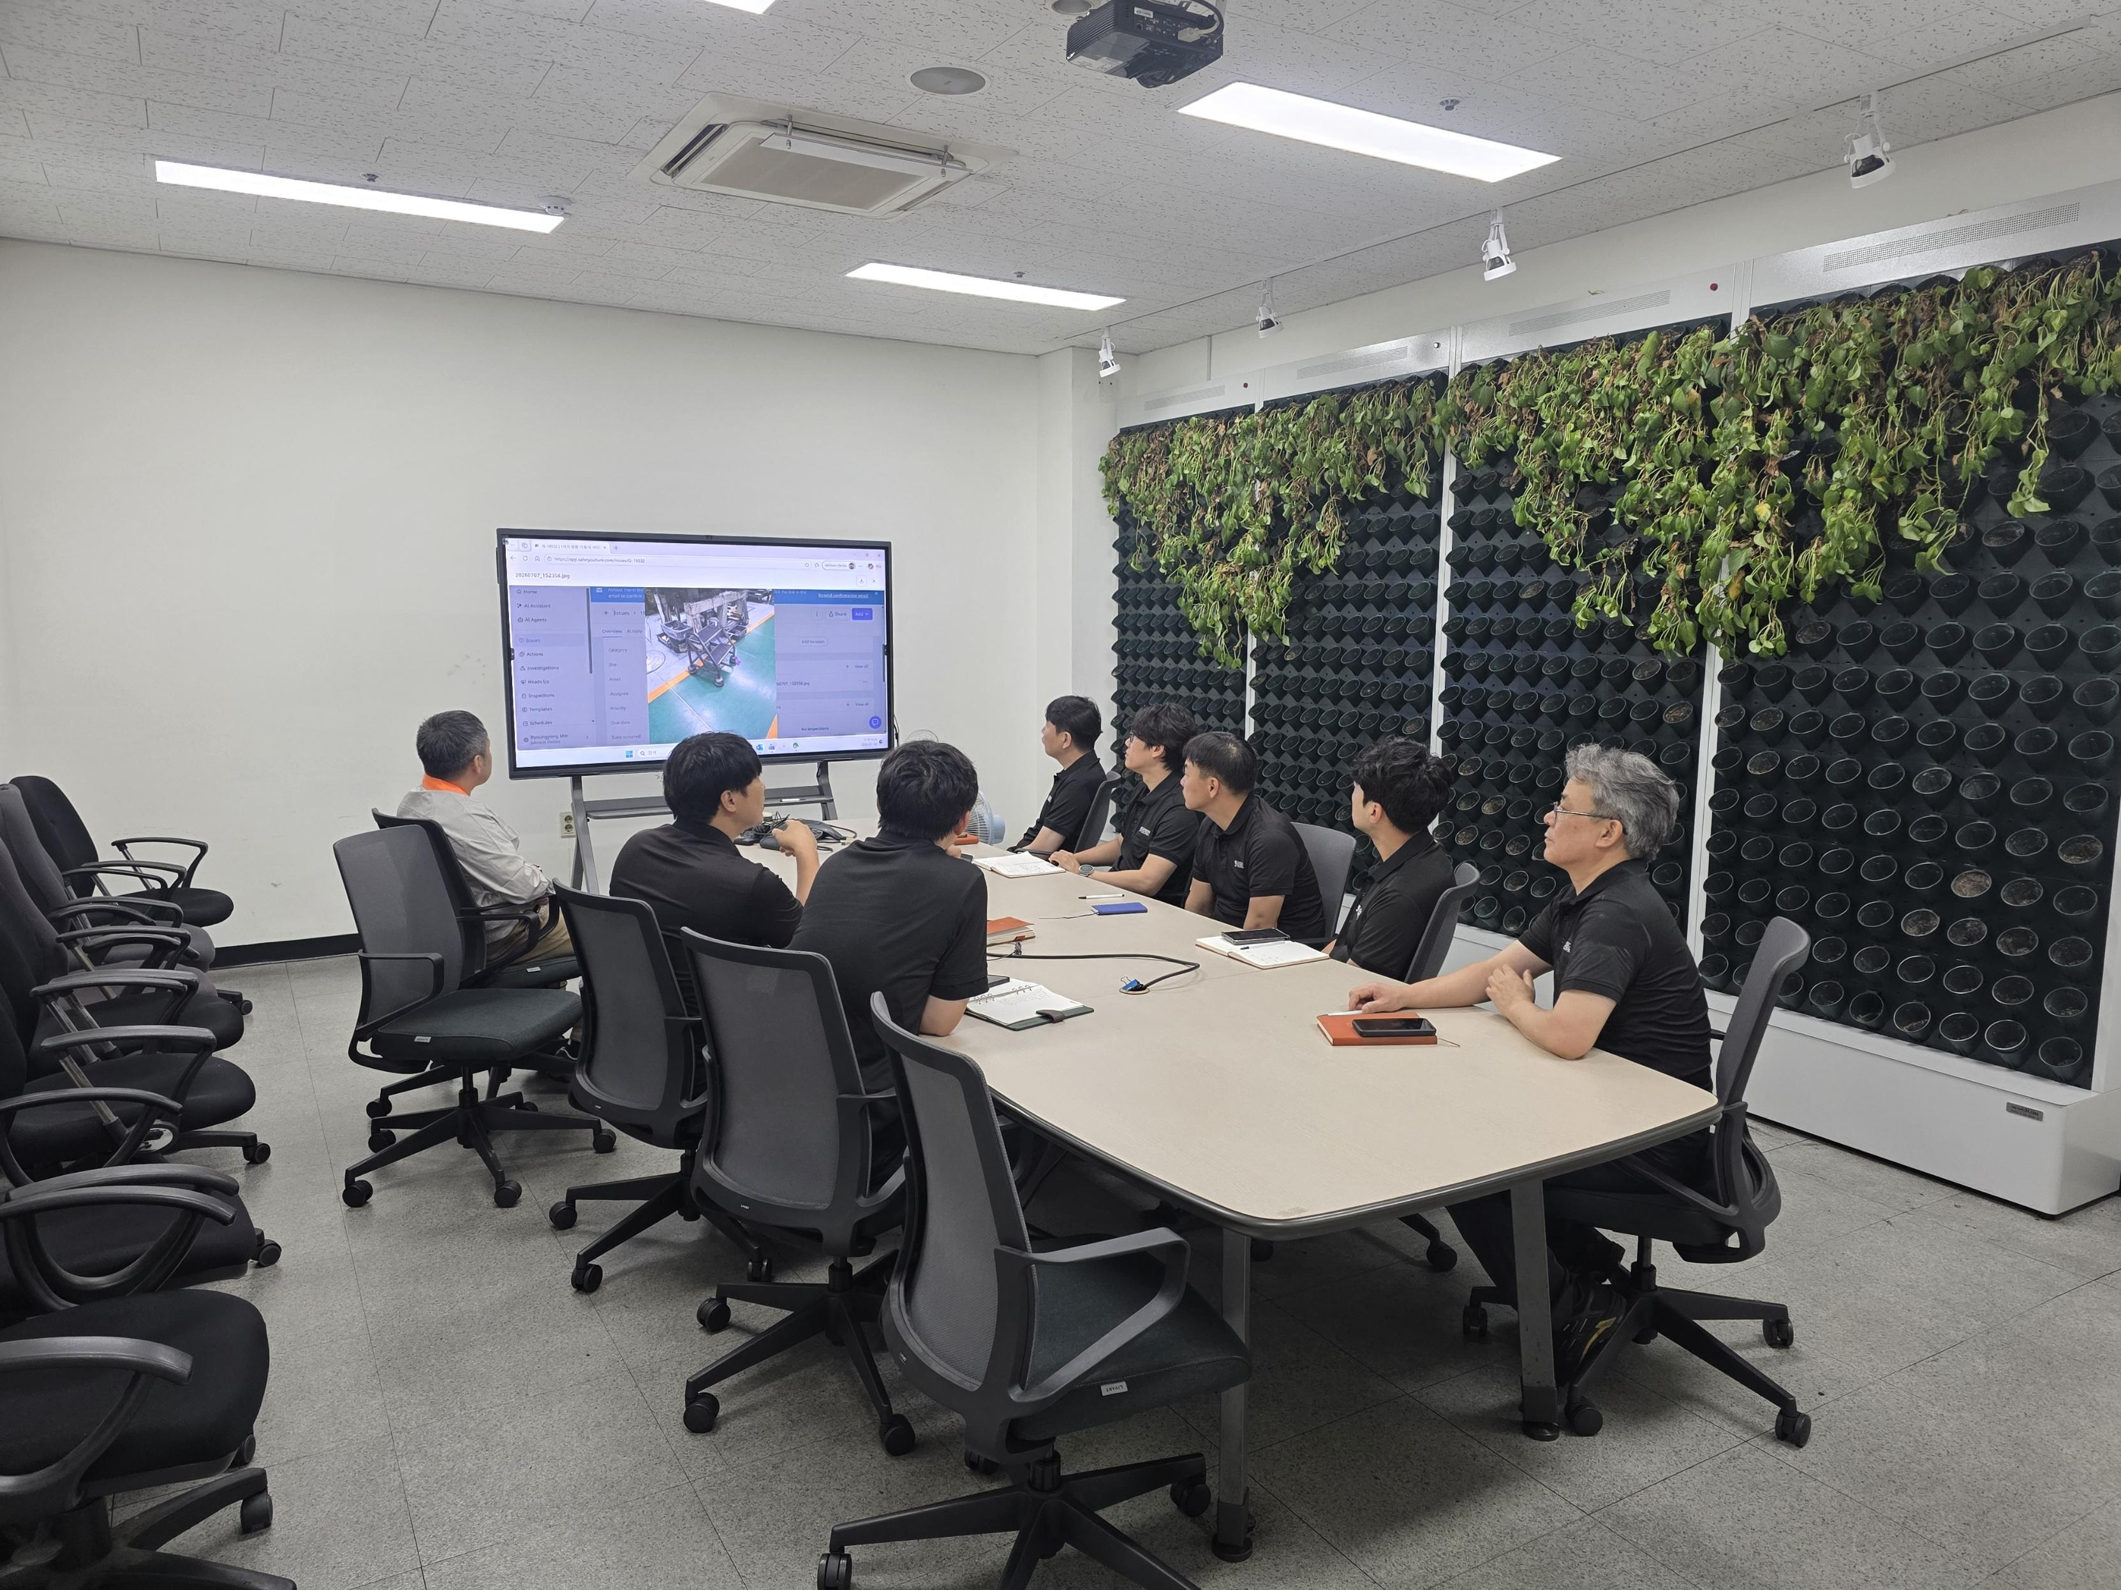
Weekly Update of Safety Culture Platform
Number Summary
Site | Safety Alert | FY26/27 Target | FY26/27 YTD By Jun | Last 2 Week (7.04-7.18)
 |  |  |  | Safety Alert | Close | Open | Action
JEO Korea | Hazards & Issue | 504 | 128 | 16 | 5 | 11 | 7
JEO Korea | Near Miss | 12 | 3 | 0 | 0 | 0 | 0
Total |  | 516 | 131 | 16 | 5 | 11 | 7
Summary of May
The photo of Safety Alerts Review
Safety Alert | FY26/27 Target | Apr | May | Jun | July
 |  |  |  |  | Safety Alert | Close | Open | Action
Hazards & Issue | 504 | 42 | 51 | 35 | 29 | 10 | 19 | 9
Near Miss | 12 | 1 | 0 | 2 | 0 | 0 | 0 | 0
Total | 504 | 43 | 51 | 37 | 29 | 10 | 19 | 9

